Slide 1
H1-B Visa Status Prediction
By Ali Asgar Amar and Akshay Gurao

Slide 2
Introduction
Our project aims at doing analysis on the data from last five years collected from the dataset and predict if an applicant is eligible with the help of machine learning.
We analyzed the data to find out how different parameters help in the eligibility of the applicant.
Finally we created a web application where in we enter the parameters and the application by using the past data predicts if the applicant is eligible or not.

Slide 3
Technologies Used
Hadoop MapReduce
Machine Learning using R
Spring Framework for Web Development
Deployed the website on Microsoft Azure

Slide 4
Why Hadoop Mapreduce?
Hadoop is a robust and powerful piece of Big Data technology.
A MapReduce job usually splits the input data-set into independent chunks which are processed by the map tasks in a completely parallel manner.
The framework sorts the outputs of the maps, which are then input to the reduce tasks.

Slide 5
Why Machine Learning with R?
R is one of the most powerful machine learning platforms and is used by the top data scientists in the world.
R is powerful because of the breadth of techniques it offers. Any techniques that you can think of for data analysis, visualization, sampling, supervised learning and model evaluation are provided in R.
R is free because it is open source software.

Slide 6
Why Spring Framework for Web Development?
The Spring Framework is an application framework and inversion of control container for the Java platform. The framework's core features can be used by any Java application, but there are extensions for building web applications on top of the Java EE (Enterprise Edition) platform.
Spring Framework is free because it is open source software.

Slide 7
Why Microsoft Azure for Deployment?
Windows Azure is Microsoft's cloud-based application platform for developing, managing, and hosting applications off-site.
Using Azure, you can easily create applications that run reliably and scale from 10 to 10 thousand or even 10 million users — without any additional coding. Azure Storage provides scalable, secure, performance-efficient storage services in the cloud.

Slide 8
Steps followed
Cleaned the dataset CSV file using Google OpenRefine
Analyzed the dataset using Hadoop MapReduce
Predicted the output by training the model using R Machine learning Libraries
Created a web application to predict the output and display the analysis

Slide 9
Cleaning using Google OpenRefine
OpenRefine is a power tool that allows you to load data, understand it, clean it up, reconcile it, and augment it with data coming from the web.

Slide 10
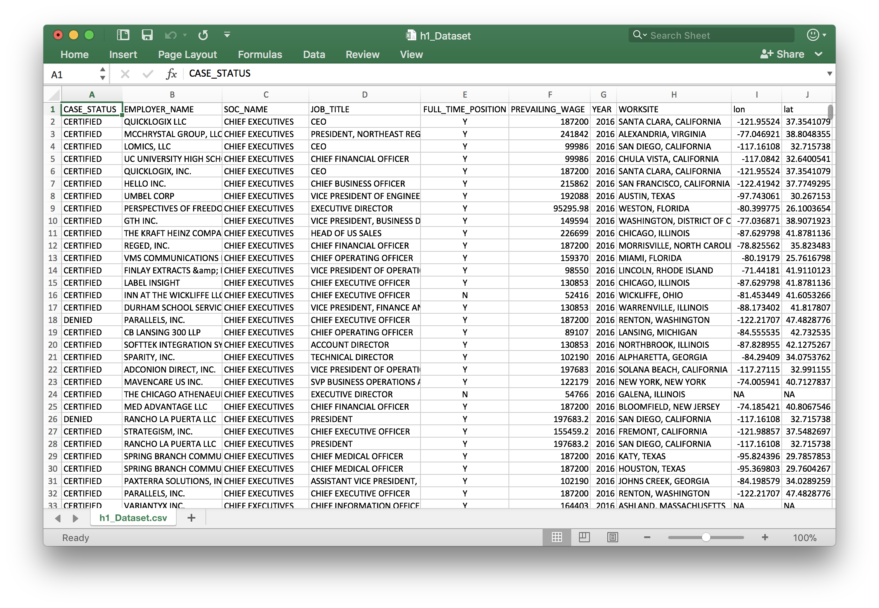
Dataset

Slide 11
Column Values
CASE_STATUS: Eligibility Status
EMPLOYER_NAME: Name of the company
SOC_NAME: Standard Occupancy Certificate
JOB_TITLE: Position of the applicant
FULL_TIME_POSITION: Fulltime or contract employee
PREVAILING_WAGE: Total wage
YEAR: Year of filling
WORKSITE: Work location
LAT: Latitude
LON: Longitude

Slide 12
Analysis Performed
Calculated the average wage for every state
Calculated average wage for every job profile
Calculated the number of certified applications by every organization
Top 10 states with highest applicants
Top 20 companies with highest petitions certified
Total petitions certified or declined every year.

Slide 13
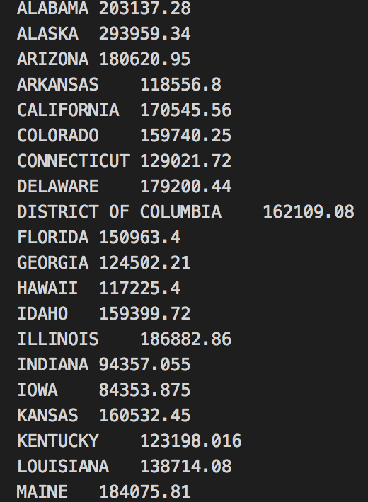
Hadoop Analysis

Slide 14
A BAR GRAPH SHOWING THE AVERAGE WAGE OF EACH STATE FROM THE DATASET

Slide 15
Machine Learning in R
Libraries used: randomForest, party, dplyr, tidyr, sqldf, caret, glmnet, car, ROCR, gbm
Algorithms used:
Logistic Regression
Decision Tree

Slide 16
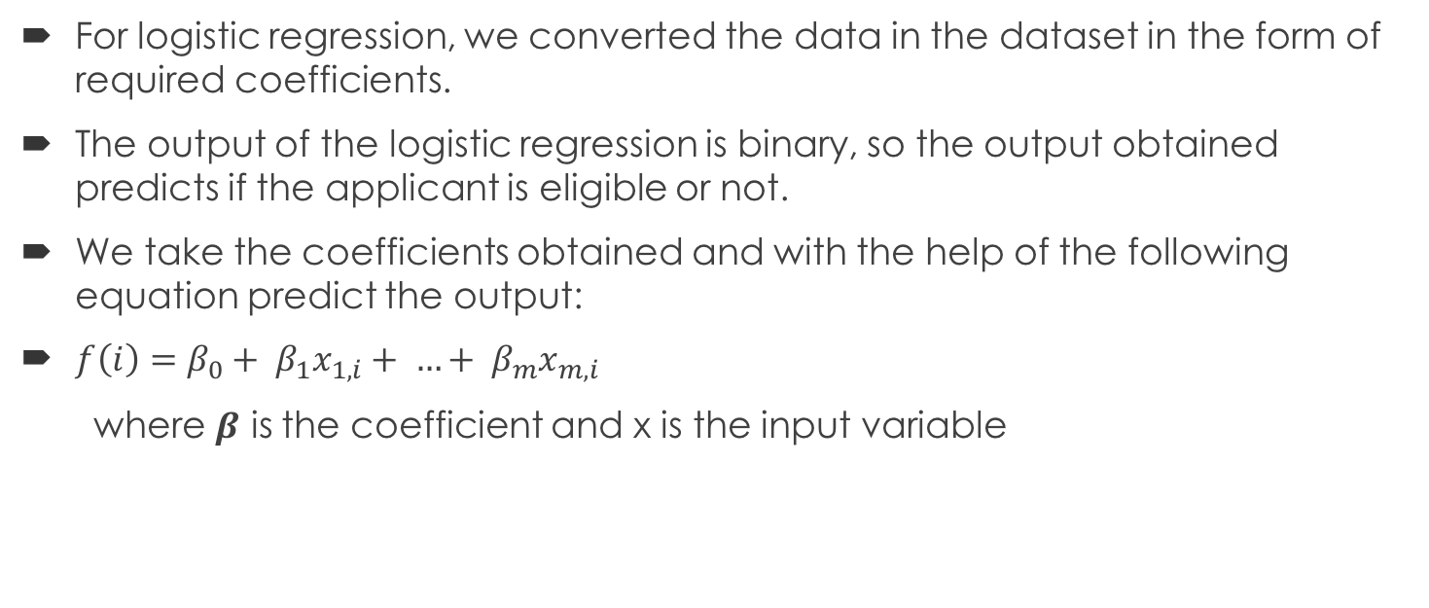
Steps for Logistic Regression
For logistic regression, we converted the data in the dataset in the form of required coefficients.
The output of the logistic regression is binary, so the output obtained predicts if the applicant is eligible or not.
We take the coefficients obtained and with the help of the following equation predict the output:
$f\left(i\right)=β_{0}+ β_{1}x_{1,i}+ …+ β_{m}x_{m,i}$
where 𝜷 is the coefficient and x is the input variable

Slide 17
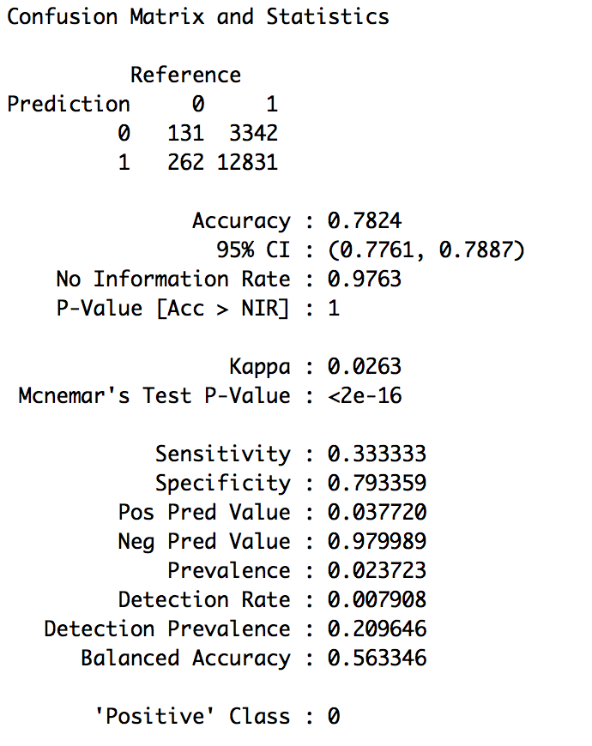
LOGISTIC REGRESSION OUTPUT

Slide 18
Steps for Decision Tree
A decision tree is a flow-chart-like structure, where each internal node denotes a test on an attribute, each branch represents the outcome of a test, and each leaf node holds a class label. The topmost node in a tree is the root node.
Information Gain can be used to decide which feature to split at each step. It can be calculated as follows:
IG(T,a) = H(T) - H(T|a)
where IG is the Information Gain, H(T) is the parent entropy and H(T|a) is the weighted sum of the children entropy.

Slide 19
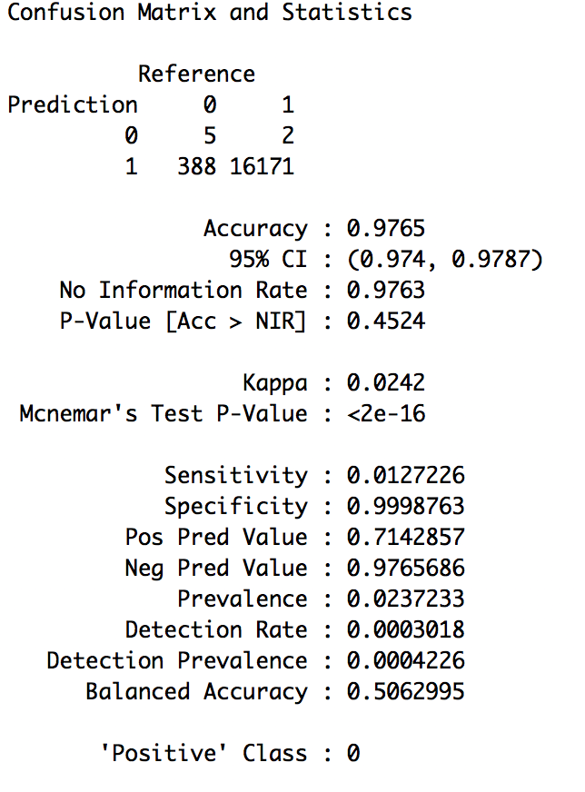
DECISION TREE OUTPUT

Slide 20
Live Demo
http://h1b.eastus.cloudapp.azure.com:28061/bigdata/

Slide 21
Thank you

